Slide 1

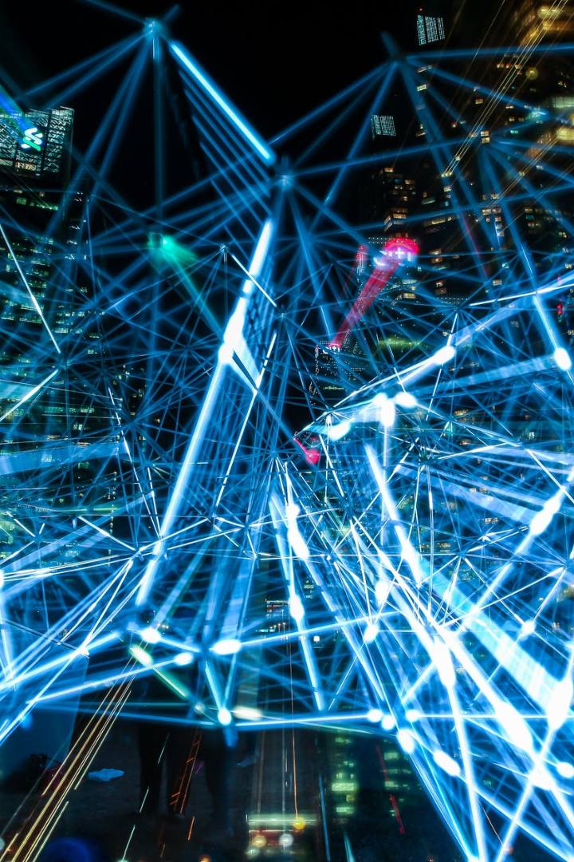
Cybersecurity in a Connected World
In today's fast-paced digital world, protecting our personal and business data is more important than ever. Join us as we explore the challenges and solutions of cybersecurity.
by Nitin Jaiswal

Slide 2

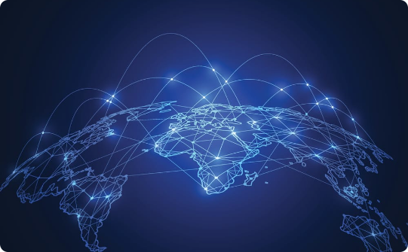
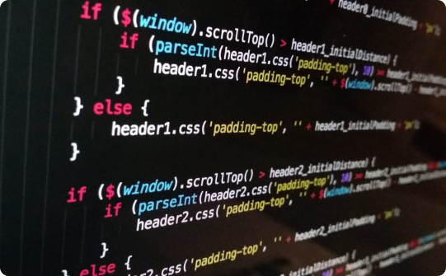
The Connected World
Ubiquitous Use
Global Interconnectivity
Increasing Technology Complexity
The widespread use of mobile phones and the Internet of Things has increased the risk of cyber-attacks, and made traditional cybersecurity methods obsolete.
The interconnectedness of different devices and platforms used globally has created new security risks, and made cybersecurity a global concern.
The increasing complexity of modern technology has created multiple attack vectors and made preventing cyber-attacks increasingly difficult.

Slide 3
Challenges of Cybersecurity
Phishing
Malware
Deceptive email and website schemes can trick users into divulging sensitive information.
Many different types of malicious software can infect a user's system and steal valuable data.
Ransomware
Insider Threats
Ransomware is a type of malware that encrypts data and demands a ransom payment to restore access.
Employees or other insiders can pose a significant cybersecurity risk by intentionally or unintentionally leaking sensitive data.

Slide 4
Common Solutions for Cybersecurity Challenges
Firewalls and Antivirus Software
Encryption
Backups and Disaster Recovery Planning
Encrypting data can protect sensitive information from malware and unauthorized access.
Traditional cybersecurity tools like firewalls and antivirus software can detect and prevent many types of cyber-attacks.
Having regular backups of data, and a plan for disaster recovery, can minimize the impact of cyber-attacks.

Slide 5
Emerging Solutions for Cybersecurity Challenges
1
Artificial intelligence (AI)
AI-powered cybersecurity solutions can detect and prevent attacks in real-time, and proactively identify new types of threats.
Blockchain Technology
2
Blockchain technology can provide a secure way to store and transfer data, which can improve the overall security of digital transactions.
3
Zero Trust Architecture
Zero trust architecture is an approach to cybersecurity that requires strict access controls and continuous verification of users, devices, and applications.
Biometric Authentication
Biometric authentication, such as facial or fingerprint recognition, can provide highly secure user authentication and prevent unauthorized access.

Slide 6
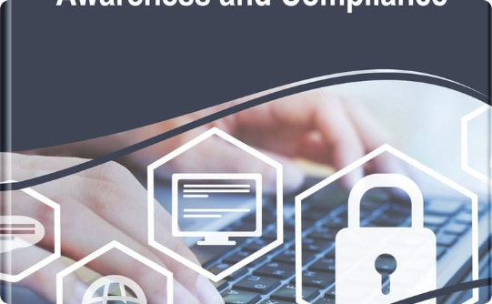

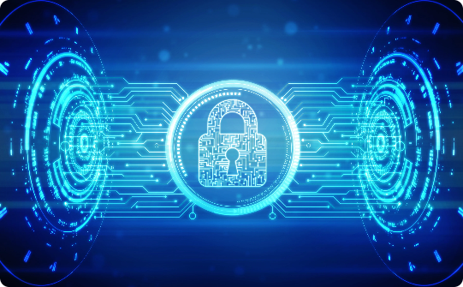
The Importance of Cybersecurity Awareness and Education
Cybersecurity Awareness
Proper Education
Benefits of Education
Empowering end-users with knowledge about common threats and best practices can improve overall security.
Proper training can prepare individuals to recognize and address various cybersecurity challenges, making them an asset to organizations.
Understanding cybersecurity best practices can help individuals protect themselves and their organizations from cyber threats, reducing unnecessary costs and risks.

Slide 7
Successful Cybersecurity Implementations
1
Microsoft
2
Goldman Sachs
3
IBM
Microsoft has an extensive cybersecurity program and has implemented measures like multifactor authentication and transparent data encryption.
Goldman Sachs has implemented biometric authentication, data encryption, and cloud security measures to protect against cyber threats.
IBM has implemented a security framework that combines analytics, intelligence, and automation to detect and respond to cyber threats effectively.

Slide 8
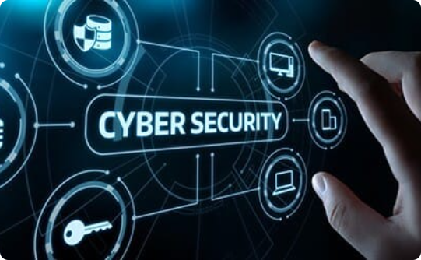
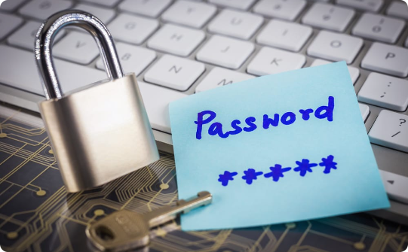

Closing and Call to Action
Don’t Wait for a Breach
Take Cyber Threats Seriously
Stay Vigilant
Act now to safeguard your organization and personal information before a cybersecurity breach occurs.
Cybersecurity is crucial to protect your digital assets and your business reputation. Take it seriously.
Cybersecurity threats are constantly evolving. Stay vigilant and keep learning.

